Slide 1
Time Sharing Option(TSO) and ISPF
Overview

Slide 2
TSO(Time Sharing Option):
Access to the computer for each user is through a terminal.
One address space per user.
User access to all resources.
File / data base sharing
User responsible for backup / recovery / restart.
Also referred to as foreground or interactive processing.

Slide 3
ISPF:
ISPF-Interactive System Product Facility
ISPF is a dialog manager, Provides dialog services. REXX or CLIST can be used to create dialogs.
Full screen editing
Split screen editing
Dialog development and testing
Library, file, dataset utilities
Language processing, debugging
Online tutorial
Context sensitive help.

Slide 4
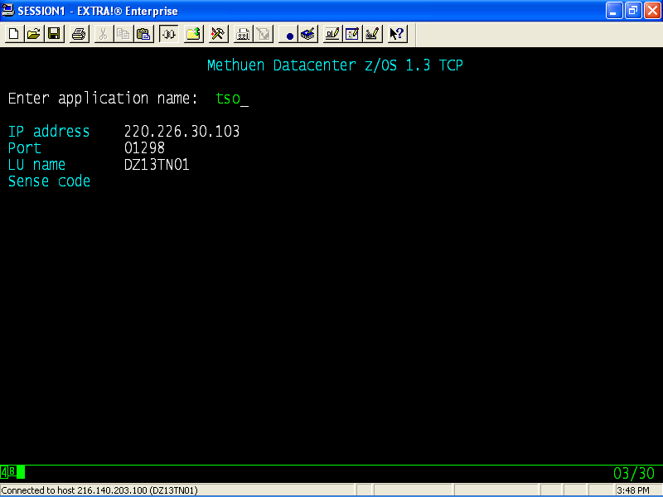
LOGON Screen

Slide 5
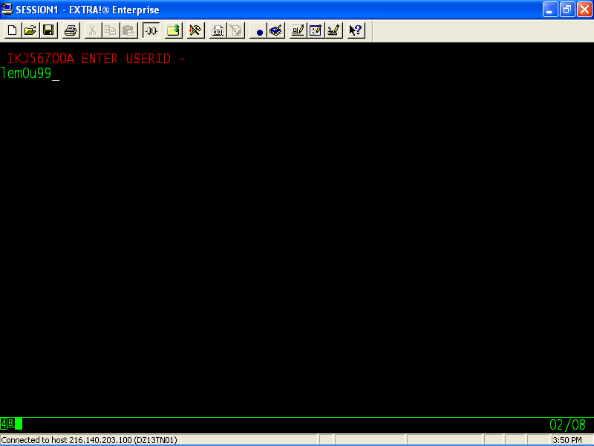
Logon Screen

Slide 6
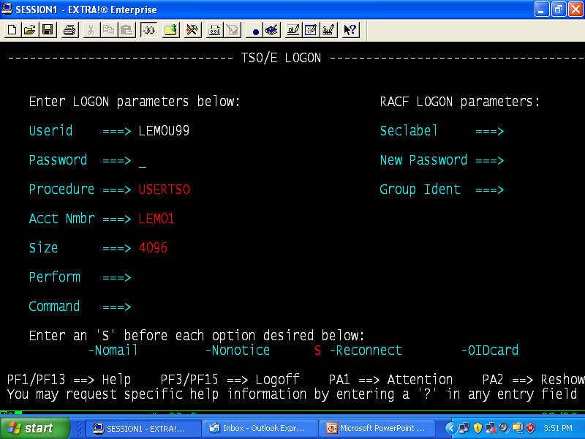
Logon Screen

Slide 7
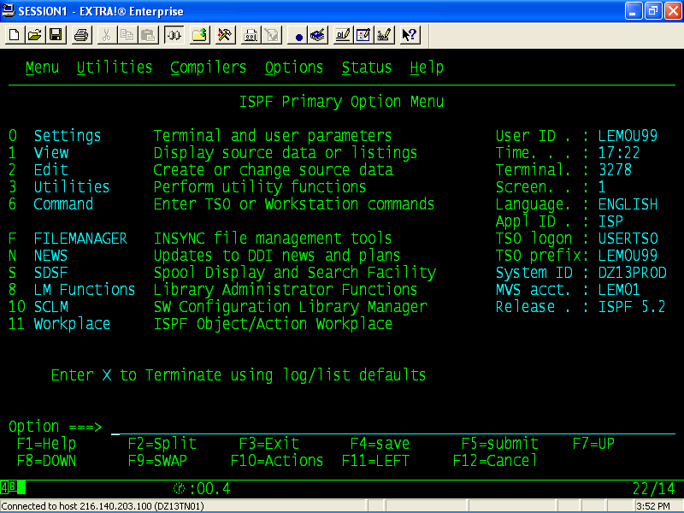
ISPF MAIN SCREEN

Slide 8
Settings
The "ISPF Settings" option allows you to display and modify selected ISPF parameters.
The main ISPF Settings panel has setting option displayed in four areas on the panel:
Options
Terminal characteristics
Print Graphics
General

Slide 9
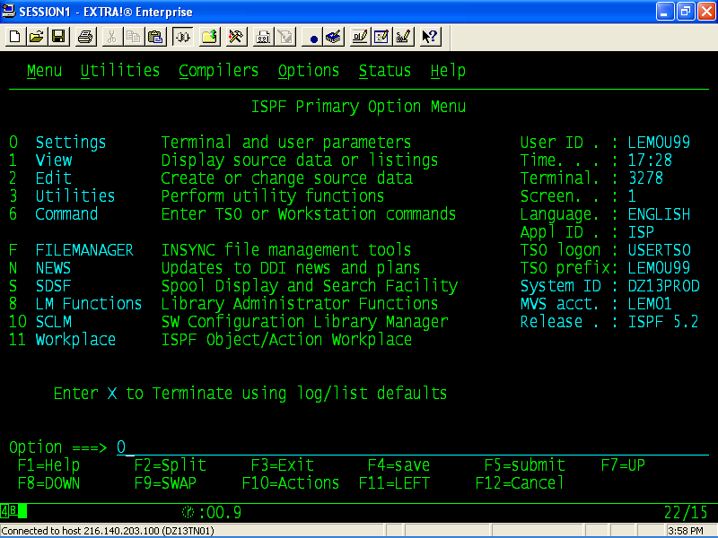
Settings

Slide 10
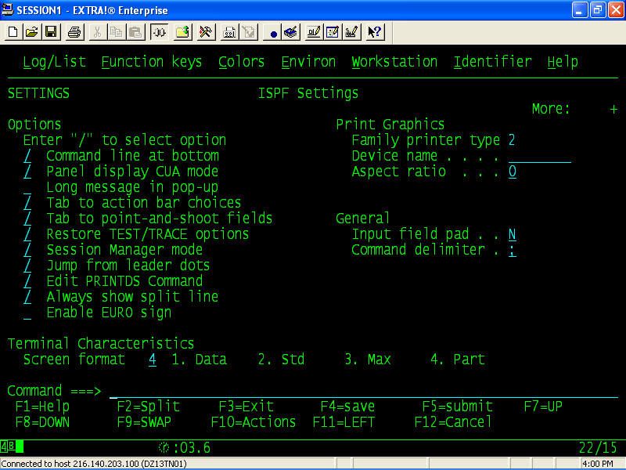
Settings

Slide 11
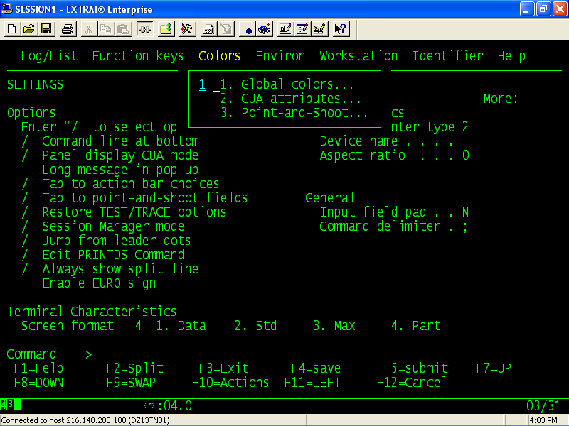
Settings

Slide 12
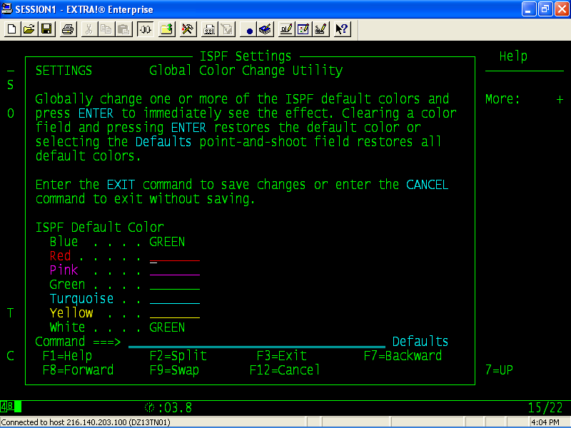
Setting

Slide 13
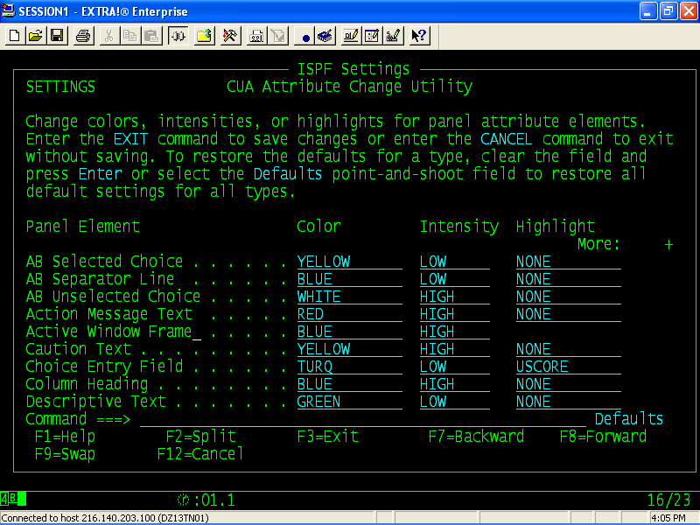
ISPF SETTINGS

Slide 14
Creating Dataset
Overview

Slide 15
Data Set
A Data set is defined as a collection of data which resides in the storage device, accessed and used by the input/output system.
Data sets can reside on DASD, Magnetic tapes or Magnetic cartridges.
MAINFRAME
DASD
MANAGETIC
CATRIDGES
MANAGETIC
TAPES

Slide 16
Data Set Organizations
There are two types of data set organizations.
VSAM Data Sets
Non-VSAM Data Sets.

Slide 17
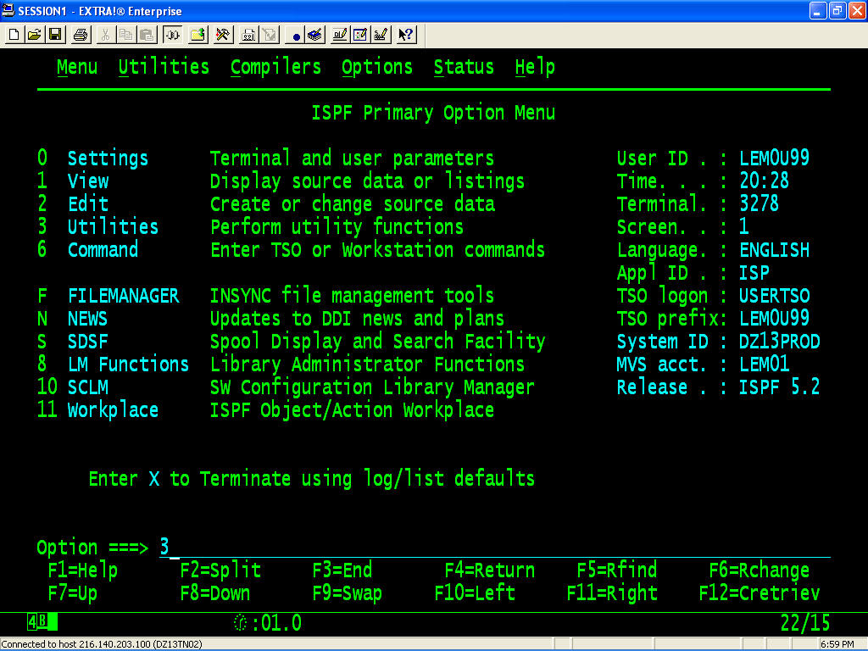

Slide 18
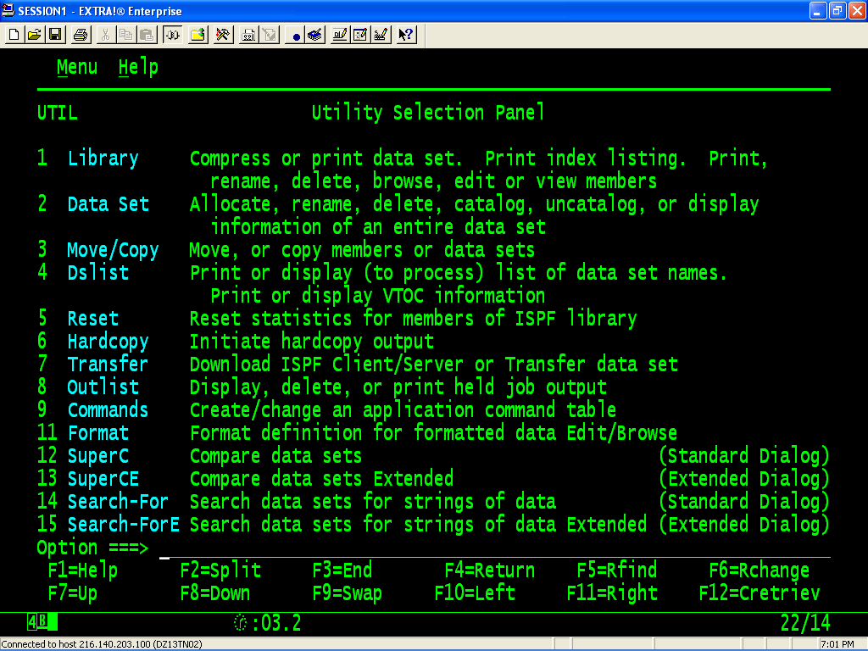
Utilities

Slide 19
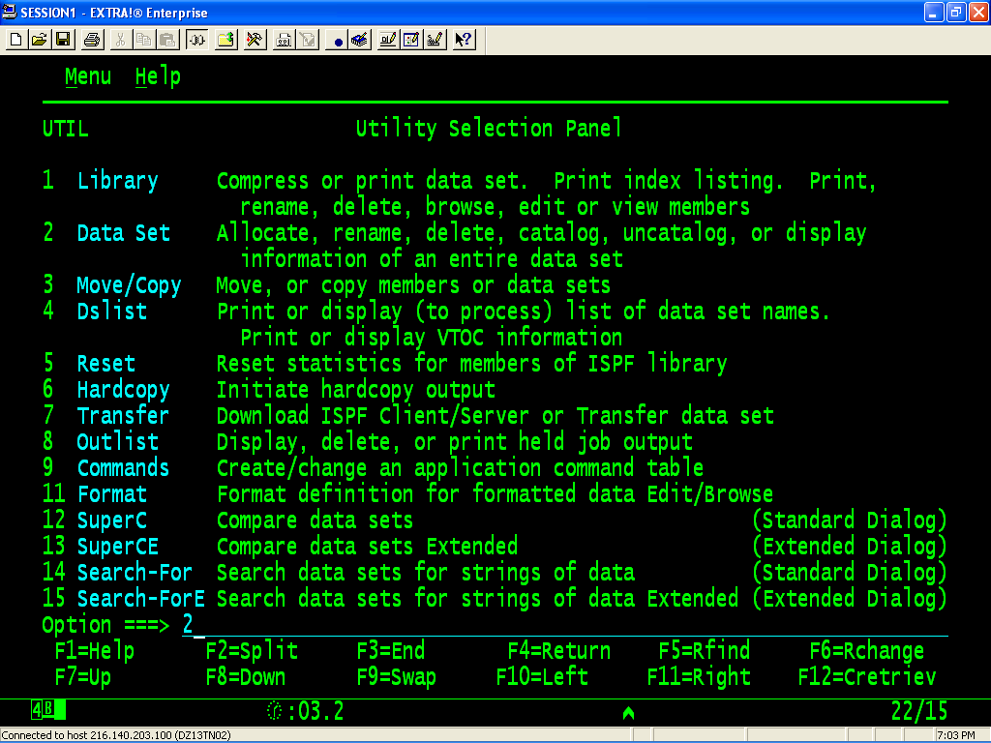
Creating Dataset

Slide 20
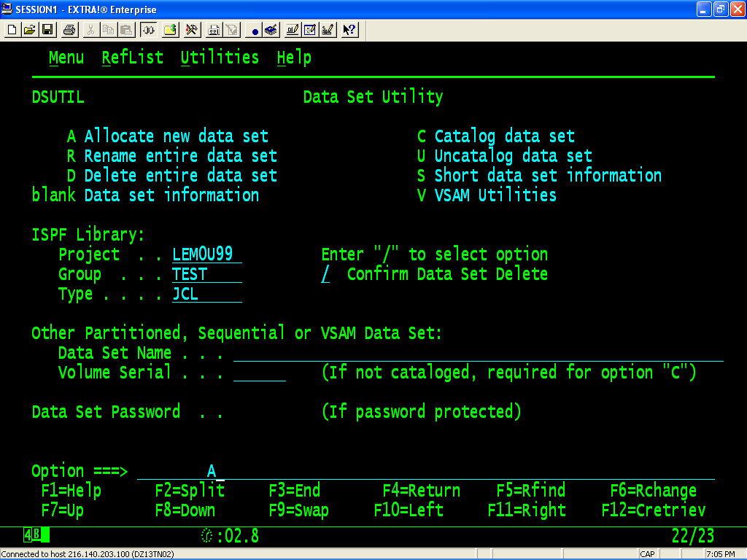
Creating Dataset

Slide 21
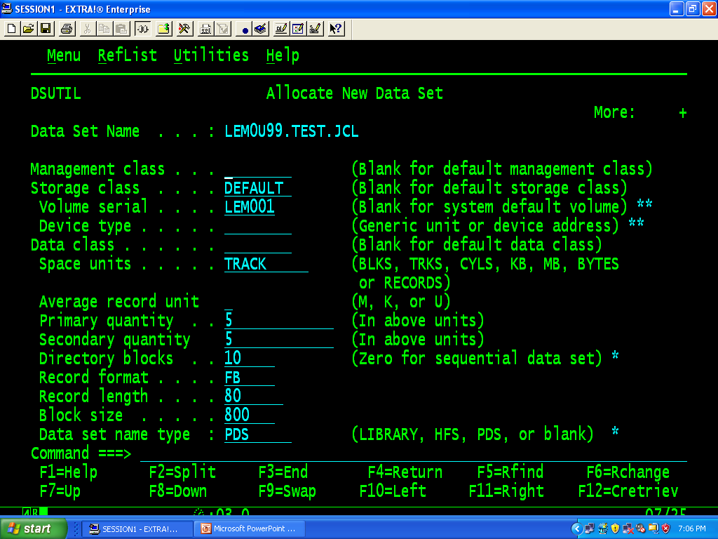
CREATING Dataset

Slide 22
DATASET
MANAGEMENT CLASS
The management class that should be used to obtain the data management related information (migration, backup, and retention criteria) for the allocation of the data set.
STORAGE CLASS
The storage class that should be used to obtain the storage related information for the allocation of the data set.
DATA CLASS
The data class that should be used to obtain the data related information (SPACE, LRECL, etc.) for the allocation of the data set.
VOLUME SERIAL/GENERIC UNIT:
The volume serial of the direct access volume you wish to contain the data set, or
The generic unit address for the direct access volume you wish to contain the data set

Slide 23
Tracks and Cylinders
Distinguish between a track and a cylinder
Recognize data management terms
Identify format and record block characteristics
Describe how to access records in different file types
Describe ways to find a file
TRACK
CYLINDER

Slide 24
Format & Record Block
F: Fixed, not grouped in blocks
FB: Fixed, grouped in blocks
V: Variable, not grouped in blocks
VB: Variable, grouped in blocks
VBS: Variable, grouped in blocks, expanded
1 record
U: Undefined
1 record

Slide 25
Datasets
SPACE UNITS - any of the following:
TRKS if data set size is expressed in tracks, or
CYLS if data set size is expressed in cylinders, or
BLKS if data set size is expressed in number of blocks of the
size specified by the block size field, or
BYTES if data set size is expressed in bytes, or
KB if data set size is expressed in kilobytes, or
MB if data set size is expressed in megabytes, or
RECORDS if data set size is expressed in average number of
records of the size specified by the block size field.
PRIMARY QUAN:
The primary allocation quantity in tracks, cylinders, blocks, kilobytes, megabytes, bytes, or records as indicated in the SPACE UNITS field.
SECONDARY QUAN:
The secondary allocation quantity in tracks, cylinders, blocks,kilobytes, megabytes, bytes, or records as indicated in the SPACE UNITS field.

Slide 26
DATASET
RECORD FORMAT - any valid combination of the following codes:
F - Fixed length records
V - Variable length records
U - Undefined format records
B - Blocked records
RECORD LENGTH:
The logical record length, in bytes, of the records to be stored in the data set.
BLOCK SIZE:
The block size (physical record length), in bytes, of the blocks to be stored in the data set. If records are specified, the block size specifies the average record length.

Slide 27
DATASET
DATA SET NAME TYPE - Any of the following:
LIBRARY - allocates a partitioned data set extended.
PDS - allocates a partitioned data set.
blank - allocates a partitioned or sequential data set based on
the data set characteristics entered.
EXPIRATION DATE:
The expiration date specifies the date when the data set may be deleted. The date can be entered in one of the following formats:
YY/MM/DD or YYYY/MM/DD (or equivalent NLS date format)
YY.DDD or YYYY.DDD (Julian form)
DDDD (Retention period in days, maximum of 9999)
Blank (No expiration date desired)

Slide 28
Dataset Organization
Data Set Naming Rules
Allows - Alpha, Digits, National Characters @,#$, and “.”
Maximum Length 44 characters for DASD, 17 for Tape
If Length is more than 8, must be broken into qualifiers of maximum 8
characters each
Qualifiers are separated by “.”
“.” are counted in overall length
First character of the qualifier must be alpha or national character
Last character of data set must not be “.”
First qualifier is called as high-level qualifier

Slide 29
Catalog
A catalog is an area of memory available in every volume to store the information about the data sets available in the volume.
There are two types of Catalogs available:
User catalogs.
Master Catalogs.

Slide 30
Master
Catalog
User
Catalogs
System
Datasets
User
Datasets

Slide 31
User and Master Catalogs
User catalogs contain the information about the various User data sets available on the volume.
The number of user catalogs depend on the number of users.
Master catalogs contain the information about the various user catalogs and the system data sets available.
There is only one Master catalog per system, but there are many user catalogs available.

